Slide 1
K-MEANS CLUSTERING-BASED IN-DEPTH DATA MINING METHOD FOR NETWORK SHARED RESOURCES

Slide 2
ABSTRACT:-
In order to improve the accuracy and efficiency of in-depth data mining of network shared resources, a new method of in-depth data mining of network shared resources based on K-means clustering is designed. The advantages of K-means clustering algorithm are analyzed, and the clustering processing of network shared resource data is carried out by K-means clustering algorithm, and the data feature vectors in the clustering results are extracted. Based on the data feature vector extraction results, a deep mining model of network shared resource data is built, and the model is solved, and the results of deep mining of network shared resource data are output. Experimental results show that this method can achieve accurate and fast network shared resource data deep mining, practical application effect is better.

Slide 3
EXSISTING SYSTEM | PROPOSED SYSTEM
The preliminary data mining results are evaluated, and the data are screened according to the evaluation results, and the results are taken as the final results of the deep mining of resource data. However, this method is too complicated and time-consuming for data mining, which makes it difficult to achieve the ideal application effect. Reference proposed a deep data mining method based on multi-dimensional resource coordination and aggregation. This method is mainly for network resource sharing process analysis of the data center as the foundation, and build a multidimensional resource aggregation data model, using fuzzy logic to build multidimensional collaborative fitness function, on the basis of to filter the key operator in the process of data mining, and the decision-making optimization, data mining in order to improve the execution efficiency of data mining process. | K-means clustering algorithm has become one of the most widely used algorithms. Due to its advantages of high data processing efficiency, low computational complexity and strong scalability, this algorithm has become the most well-known and commonly used algorithm in the process of data collection. The main advantages of this algorithm are as follows: Firstly, in the process of handling data set, K-means clustering algorithm can not only deal with numeric dataset, also can complete data processing tasks in this paper, and the image data sets, its process has strong robustness, especially using the algorithm of dealing with the class and the class has a large gap between the data set, the classification results better.
EXISTINGALGORITHM:- Fuzzy Logic | PROPOSED ALGORITHM:- IN-DEPTH DATA MINING OF NETWORK

Slide 4
ALGORITHM DEFINITION:- | ALGORITHM DEFINITION:-
The 'Fuzzy' word means the things that are not clear or are vague. Sometimes, we cannot decide in real life that the given problem or statement is either true or false. At that time, this concept provides many values between the true and false and gives the flexibility to find the best solution to that problem. Fuzzy logic contains the multiple logical values and these values are the truth values of a variable or problem between 0 and 1 This concept provides the possibilities which are not given by computers, but similar to the range of possibilities generated by humans. | In order to improve the accuracy and efficiency of in-depth data mining of network shared resources, a new method of in-depth data mining of network shared resources based on K-means clustering is designed. The advantages of K-means clustering algorithm are analyzed, and the clustering processing of network shared resource data is carried out by K-means clustering algorithm, and the data feature vectors in the clustering results are extracted. Based on the data feature vector extraction results, a deep mining model of network shared resource data is built, and the model is solved, and the results of deep mining of network shared resource data are output. Experimental results show that this method can achieve accurate and fast network shared resource data deep mining, practical application effect is better.

Slide 5
DRAWBACKS:- | ADVANTAGES:-
In the classification process of numerical data sets by using K-means clustering algorithm, the input sequence of data objects has little influence on the classification results. First, an intuitive language evaluation set that considers emotional and ontological features was constructed based on statistical rules. K-means clustering algorithm can deal with large data sets. | Focus on the problem Index weight value based Evaluation set that consider

Slide 6
MINIMUMSYSTEM REQUIREMENTS
HARDWARE REQUIREMENTS
PROCESSOR : DUAL CORE 2 DUO.
RAM : 2GB DD RAM
HARD DISK : 250 GB
SOFTWARE REQUIREMENTS
FRONT END : J2EE (JSP, SERVLET)
BACK END : MY SQL 5.5
OPERATING SYSTEM : WINDOWS 7
IDE : ECLIPSE

Slide 7
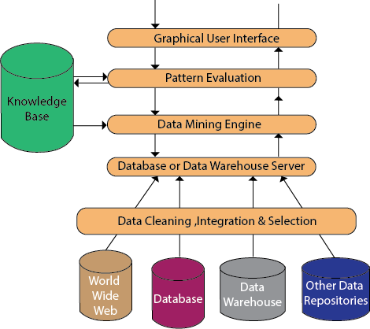
System Architecture

